Slide 1
RESUME SCREENING
BASED ON JOB DESCRIPTION
USING PYTHON
BY-AISHWARYA KAMBOJ
2017451

Slide 2
PRESENTATION OUTLINE
INTRODUCTION
STATEMENT PROBLEM
TOOLS AND SOFTWARE USED
METHODOLOGY
DIFFICULTIES FACED
FURTHER IMPROVEMENT
LIMITATIONS
FUTURE PLAN

Slide 3
INTRODUCTION
Resume screening is the process of determining whether a candidate is qualified for a role based on his or her education, experience, and other information captured on their resume.
It’s a form of pattern matching between a job’s requirements and the qualifications of a candidate based on their resume.
The goal of screening resumes is to decide whether to move a candidate forward – usually onto an interview – or to reject them.

Slide 4
WHY DO WE NEED RESUME SCREENING
For each recruitment, companies take out the resume, referrals and go through them manually.
Companies often received thousands of resumes for every job posting.
When companies collect resumes then they categorize those resumes according to their requirements and then they send the collected resumes to the Hiring Team's.
It becomes very difficult for the hiring teams to read the resume and select the resume according to the requirement, there is no problem if there are one or two resumes but it is very difficult to go through 1000’s resumes and select the best one.
To solve this problem, we will screen the resume using machine learning and Nlp using Python so that we can complete days of work in few minutes.

Slide 5
STATEMENT PROBLEM
Resume screening is a project in which we determine whether a candidate is qualified for a role based on his or her education, experience, and other information captured on their resume.
The goal of screening resumes is to decide whether to move a candidate forward – usually onto an interview – or to reject them.

Slide 6
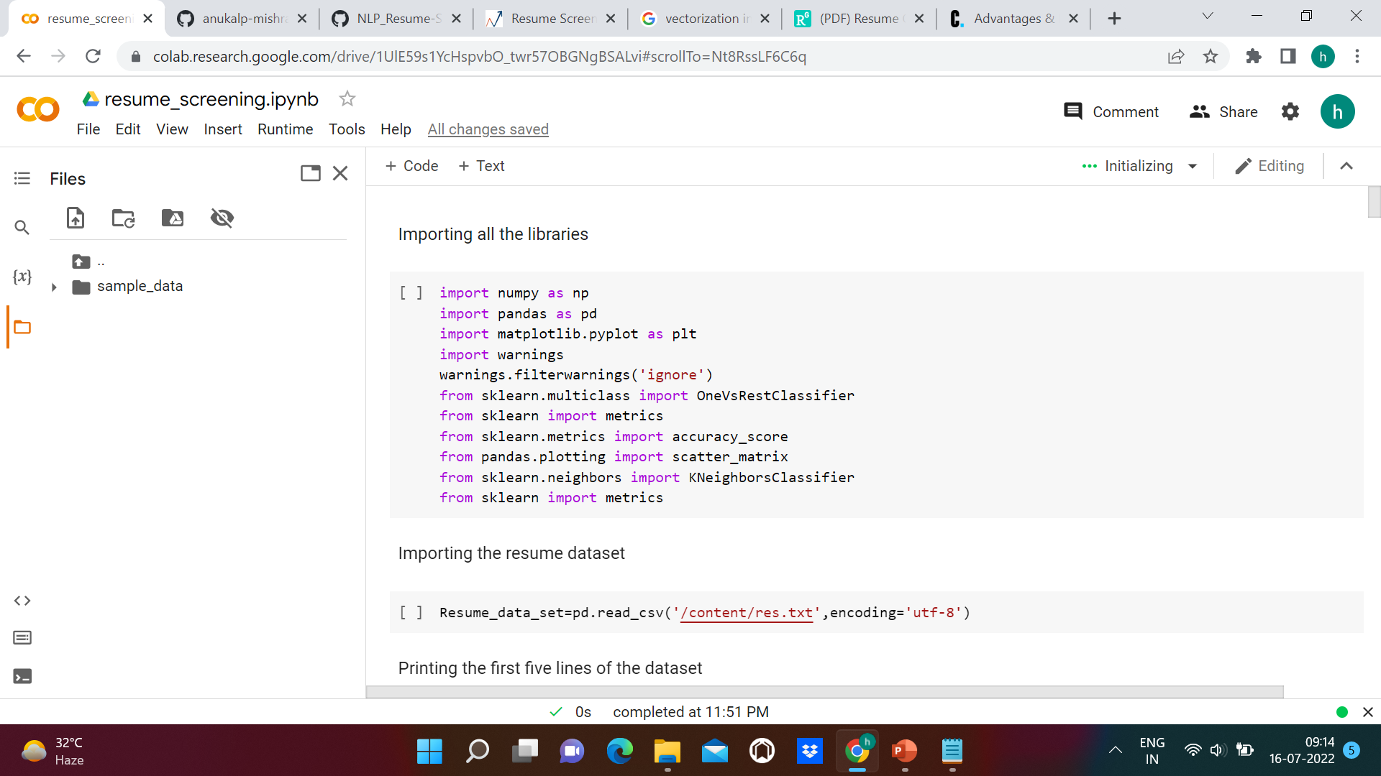
TOOLS AND SOFTWARE
SOFTWARE USED-
GOOGLE COLAB
LIBRARIES USED

Slide 7
METHODOLOGY
• DATA PREPROCESSING - With the help of the attributes present in the seaborn library we make a grid or a pie chart to properly depict the categories. We will simply display the categories that the individual or the job seeker qualifies in using a grid or a plot graph where we’ll clearly be able to analyse the users skills and abilities.
• CLEANING THE DATASET -Then we clean the dataset which means the removal of all the stopwords, and the unnecessary unrequired symbols with the help of the nltk library which will help us generate cleaned sentences. In cleaning, all special characters, the numbers, and the single letter words are removed. We got the clean dataset after these steps having no special characters, numbers or single letter word. The dataset is split into the tokens using the NLTK tokens, later other preprocessing steps are applied on the dataset.
• FEATURE SELECTION -The next step is feature extraction. On the preprocessed dataset, we have extracted the useful features using Vectorization. The cleaned out data is imported and feature extraction was carried out using Tf-Idf.
CODE: https://colab.research.google.com/drive/1UOmwdbYhTU_zuQTGNnNSxud7-cjnlavL?usp=sharing

Slide 8
DIFFICULTIES FACED
Multi-class Imbalance
Non-descriptive data

Slide 9
FUTURE PLAN
Future work for this system includes mining social networking data (e.g. Facebook, LinkedIn, GitHub profiles) of the candidates and utilizing this social behavior information in combination with resume content to make even more improved recommendations
also we can combine these classification models with the frontend resume portal where the user will be able to upload their resumes and resume classification can work in the backend.

Slide 10
LIMITATIONS
High Volume of Responses
Logistical Problems

